Slide 1

An Introductory Overview of the IMF Digital Infrastructure Costing Estimator (DICE)
January 2023
Expenditure Policy Division
Fiscal Affairs Department
Prepared by Edward Oughton, David Amaglobeli, and Mariano Moszoro

Slide 2
Motivation for the IMF Digital Infrastructure Costing Estimator (DICE)

Slide 3











Motivation
01
SDG Costing
Digital infrastructure
Definition. Physical electronic and non-electronic assets operated in a coordinated way to provide digital content, applications, and services to users.
Goal 3.
Ensure healthy lives and promote well-being for all at all ages
Goal 4.
Ensure inclusive and equitable quality education and promote lifelong learning opportunities for all
Regional points of presence
Base station tower
End-user devices and premises
Goal 6.
Ensure availability and sustainable management of water and sanitation for all
Fiber or wireless backhaul
Wireless
Goal 7.
Ensure access to affordable, reliable, sustainable and modern energy for all
Satellite backhaul
International link
Wireless
Fiber-optic cable
landing station
Target 9.1.
Develop quality, reliable, sustainable and resilient infrastructure, including regional and transborder infrastructure, to support economic development and human well-being, with a focus on affordable and equitable access for all
Wired
Target 9.C
Significantly increase access to information and communications technology and strive to provide universal and affordable access to the Internet in least developed countries by 2020
Local points of presence
Notes:
Examples. Telecom towers, underground ducting, and physical cabinet structures, electronic assets such as radio antennas, radio heads, switches, power supply units.

Slide 4
Digital Infrastructure Costing—Part of a Broader GovTech Analytical Agenda
01
Political economy of digital adoption.
Costing digital infrastructure investment
Determining factors for digital adoption
Effects of digitalization on revenue and spending efficiency
Effects of digitalization on revenue and spending efficiency
Social dividends of digital adoption
Insert your desired text here.

Slide 5
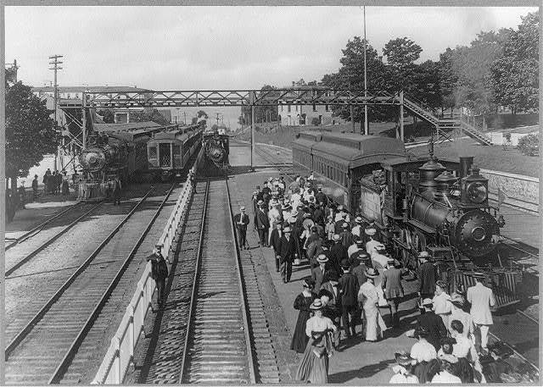
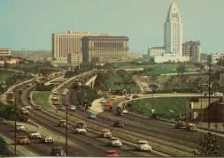

Connectivity is Key for Access and Inclusion
02
1880s railroads
1950s highways
2020s digital
Notes:
Let us start by looking at connectivity from a historical perspective.
During the late 19th century and early 20th century, it was RAILROADS that connected communities and unleashed new opportunities for growth and development.
Throughout most of the 20th century, it was HIGHWAYS that brought people and markets closer to each other.
The 21st century is the era of INTERNET.

Slide 6
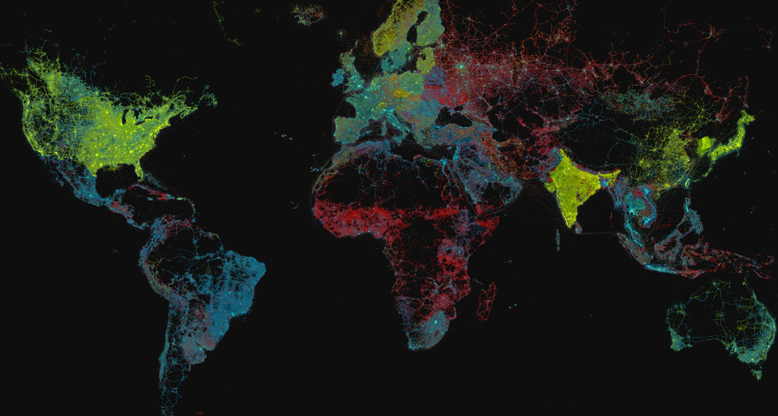
Mobile communications usage by generation (4G = yellow, 3G = blue, 2G = red)
02
Source: Del Portillo (2021).
Notes:
But yet, the world remains DIGITALLY DIVIDED. The digital divide is colossal. Only half of the global population is connected to digital services, mainly in high- and middle-income countries.
The map conveys the picture of the digital divide ACROSS countries very well. The areas colored in red and blue, where most of the world population lives, still have low connectivity.

Slide 7
Digital Divide Remains Substantial
02
Internet Connectivity by Region
(percent of population, latest year availability)
Internet Connectivity by Gender
(percent of population, latest year availability)
Source: ITU.
Source: ITU.
Notes:
Most countries in Africa, and many countries in Southeast Asia, have poor connectivity. In contrast, in most advanced economies, connectivity is near perfect. The large digital divide creates UNEQUAL OPPORTUNITIES for growth and development across countries.
This digital divide is also salient WITHIN COUNTRIES. For example, women have lower access to internet than men. This digital divide is even more staggering in low-income countries.

Slide 8
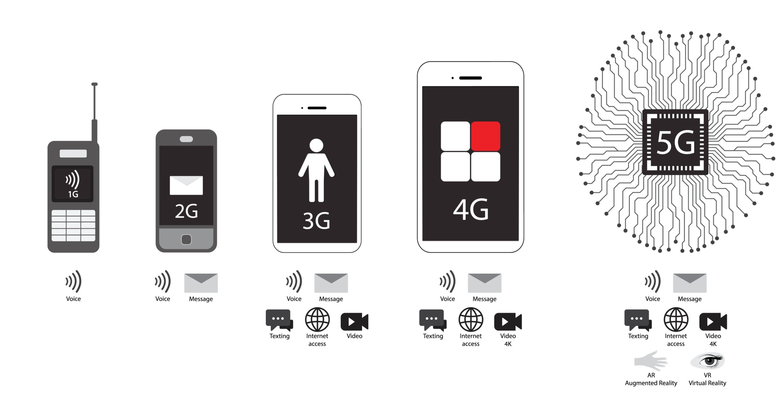
Evolution of Mobile Technology
02
Notes:
The evolution of mobile connectivity has been impressive: from voice and heavy devices to virtual reality in tiny devices.
(Btw, “odd” generations---1G, 3G, 5G---were not as disruptive at the “even” generations ;)
We focus on 4G connectivity with allows for multi-party wireless internet access at a high speed.

Slide 9
Brief Technical Background for the IMF Digital Infrastructure Costing Estimator (DICE)

Slide 10

Example of a 4G Mobile Cell Tower

Slide 11
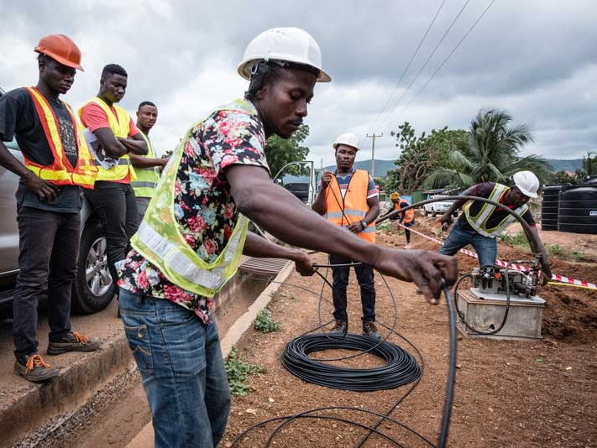
Example of Fiber Optic Link Construction

Slide 12


How do Mobile Communications Work?
Electromagnetic waves are used to transmit information between a cell tower antenna and a user device such as a smartphone
Modulating Radiowaves
Cell tower antenna
Smartphone
(Not to scale – for illustrative purposes only)

Slide 13
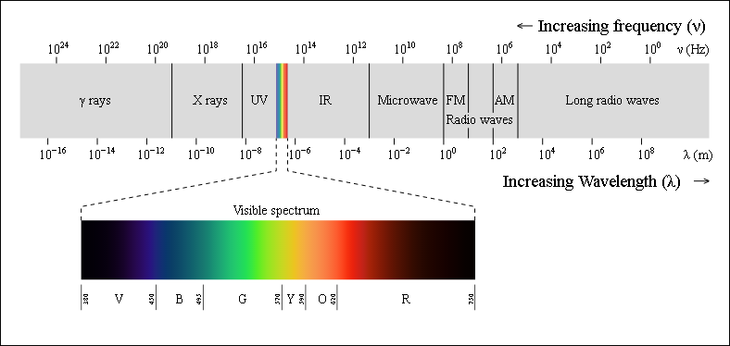
The Electromagnetic Spectrum
As part of the electromagnetic spectrum, radio waves are measured in Hertz.
The number of Hertz equates to the number of times a wave cycles per second.
Illustration of different parts of the electromagnetic spectrum, based on wavelength/frequency

Slide 14
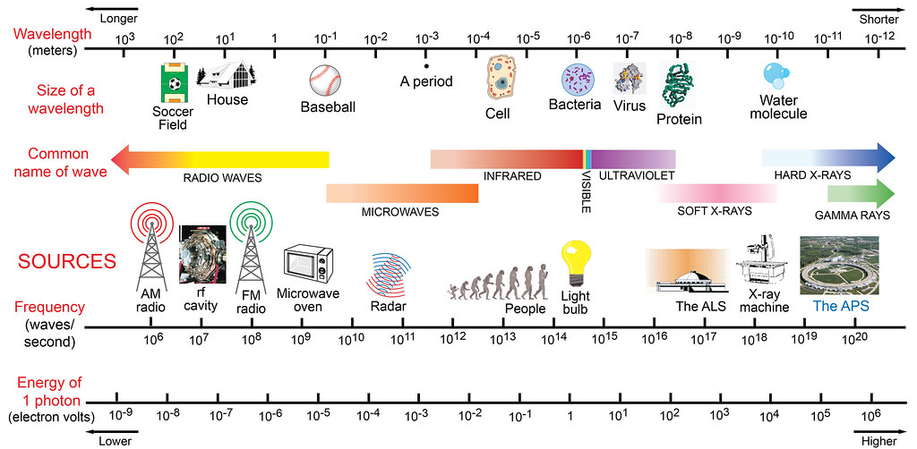
The Electromagnetic Spectrum
We use parts of the electromagnetic spectrum for lots of things. In fact, mobile communications is only one of many uses, as illustrated below.

Slide 15
Expanding the Capacity of a Mobile Network
There are three ways to expand a wireless network capacity:
Use a more efficient technology (e.g., moving from 3G to 4G), fitting more bits per Hertz on a radio wave.
Add more spectrum to transfer data over.
Build more cell sites to provide more dedicated capacity to each user.
To explain these techniques, analogies will be used based on the road transportation network

Slide 16

Option 1: Using a More Efficient Technology
(A) Imagine a road with cars driving at a 50 km/h with a constant spacing between them..
(B) And now imagine a road where the cars drive 50 km/h but with decreased spacing between each vehicle
(A)
(B)
The vehicles can be thought of as bits on a radio wave. (A) could be considered 3G, whereas (B) could be considered 4G.
By using a more efficient technology more bits (cars) can be fitted onto radiowaves (roads).
Therefore, upgrading to a more spectrally efficient technology enables faster data transfer.

Slide 17
Option 2: Add More Spectrum
(A) Imagine a road with cars driving at a 50 km/h with a constant spacing between them..
(B) And now imagine a road where the cars drive 50 km/h with a constant spacing between them, but you add more lanes.
(A)
(B)
The additional lanes on the road are equivalent to adding more spectrum channels (thus, increasing the number of radio waves available to transfer bits over).
Therefore, more spectrum enables faster data transfer.

Slide 18
Option 3: Build more cell sites to provide more dedicated capacity to each user.
Image a road (A) with cars driving at a 50 km/h with a constant spacing between them..
And now image a road (B) where the cars drive 50 km/h with a constant spacing between them, but you add more lanes.
(A)
(B)
The additional lanes on the road are equivalent to adding more spectrum channels (thus, increasing the spectrum bandwidth).
Therefore, more spectrum channels enable faster data transfer.

Slide 19
A Graphical Overview of the IMF Digital Infrastructure Costing Estimator (DICE)

Slide 20
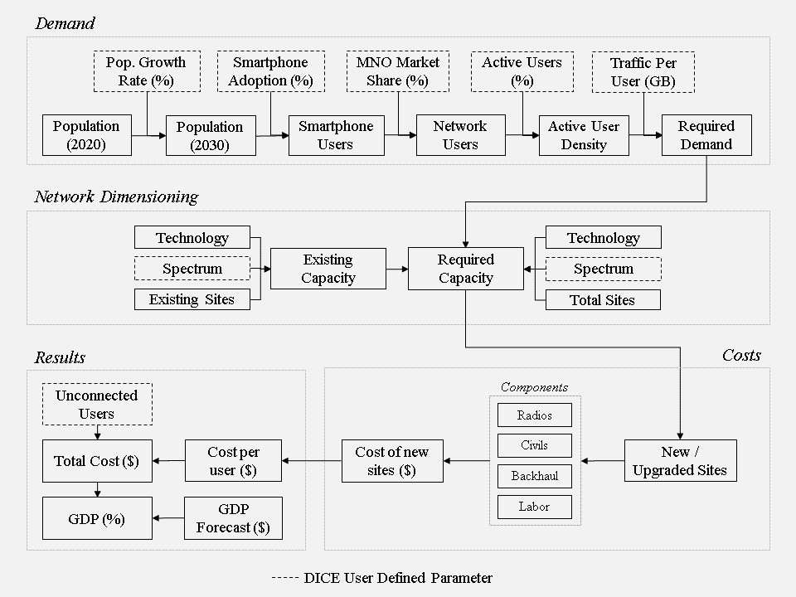
The DICE Approach

Slide 21
The Index Tab
The index tab provides general background.
For example, the aim of DICE is to support high-level decisions pertaining to universal broadband investment.
DICE can capture the main cost drivers which affect the deployment of broadband infrastructure and breakdown required investment costs for a specific country, a group of countries, or by country income groups or regions.
However, there are some important caveats.

Slide 22
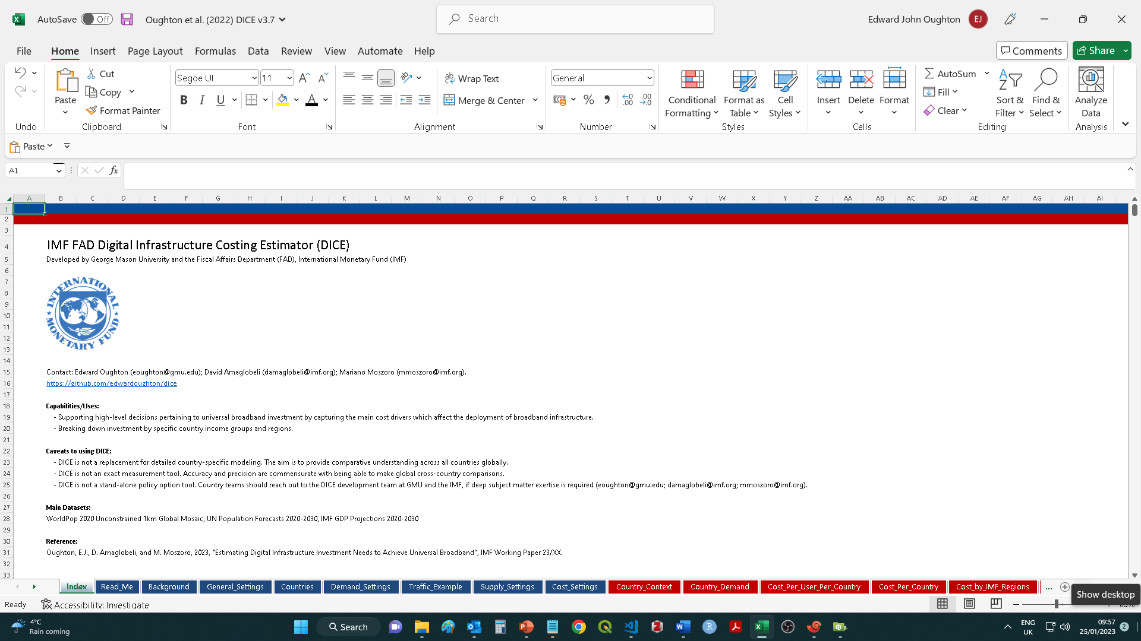
The Index Tab
DICE Capabilities and Caveats
Settings Tabs
Results Tabs

Slide 23
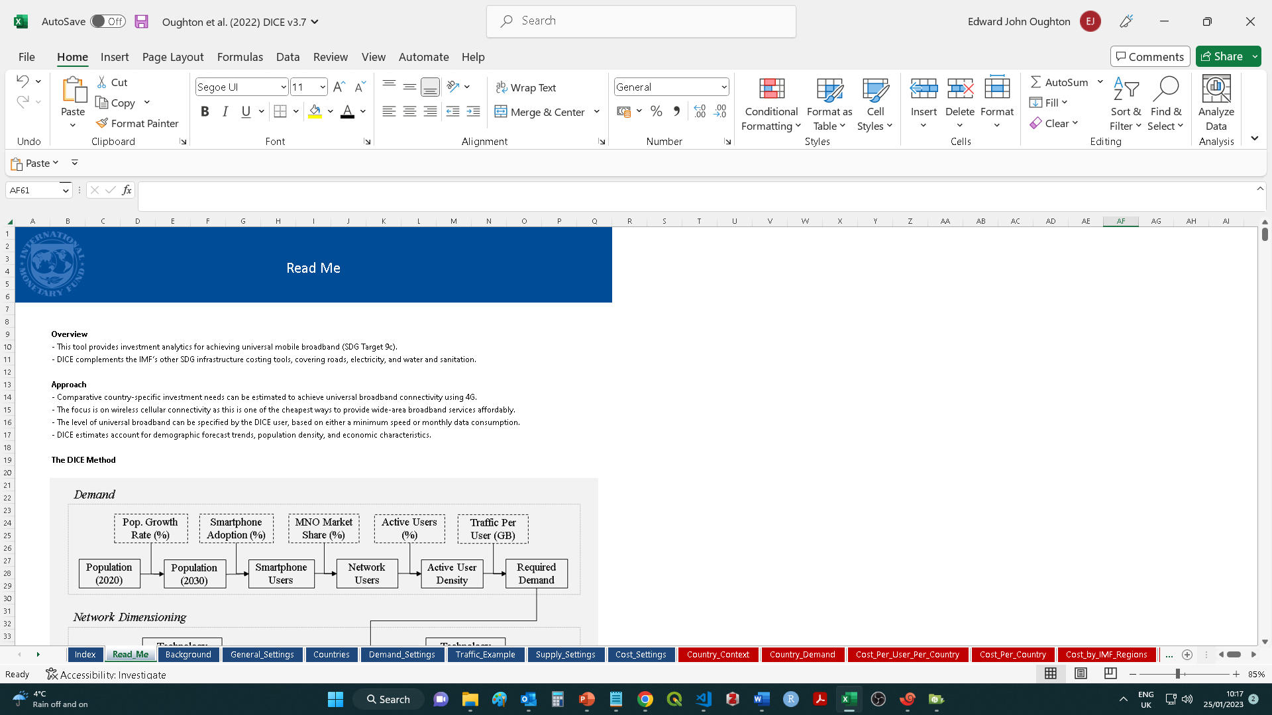
The Read Me Tab

Slide 24
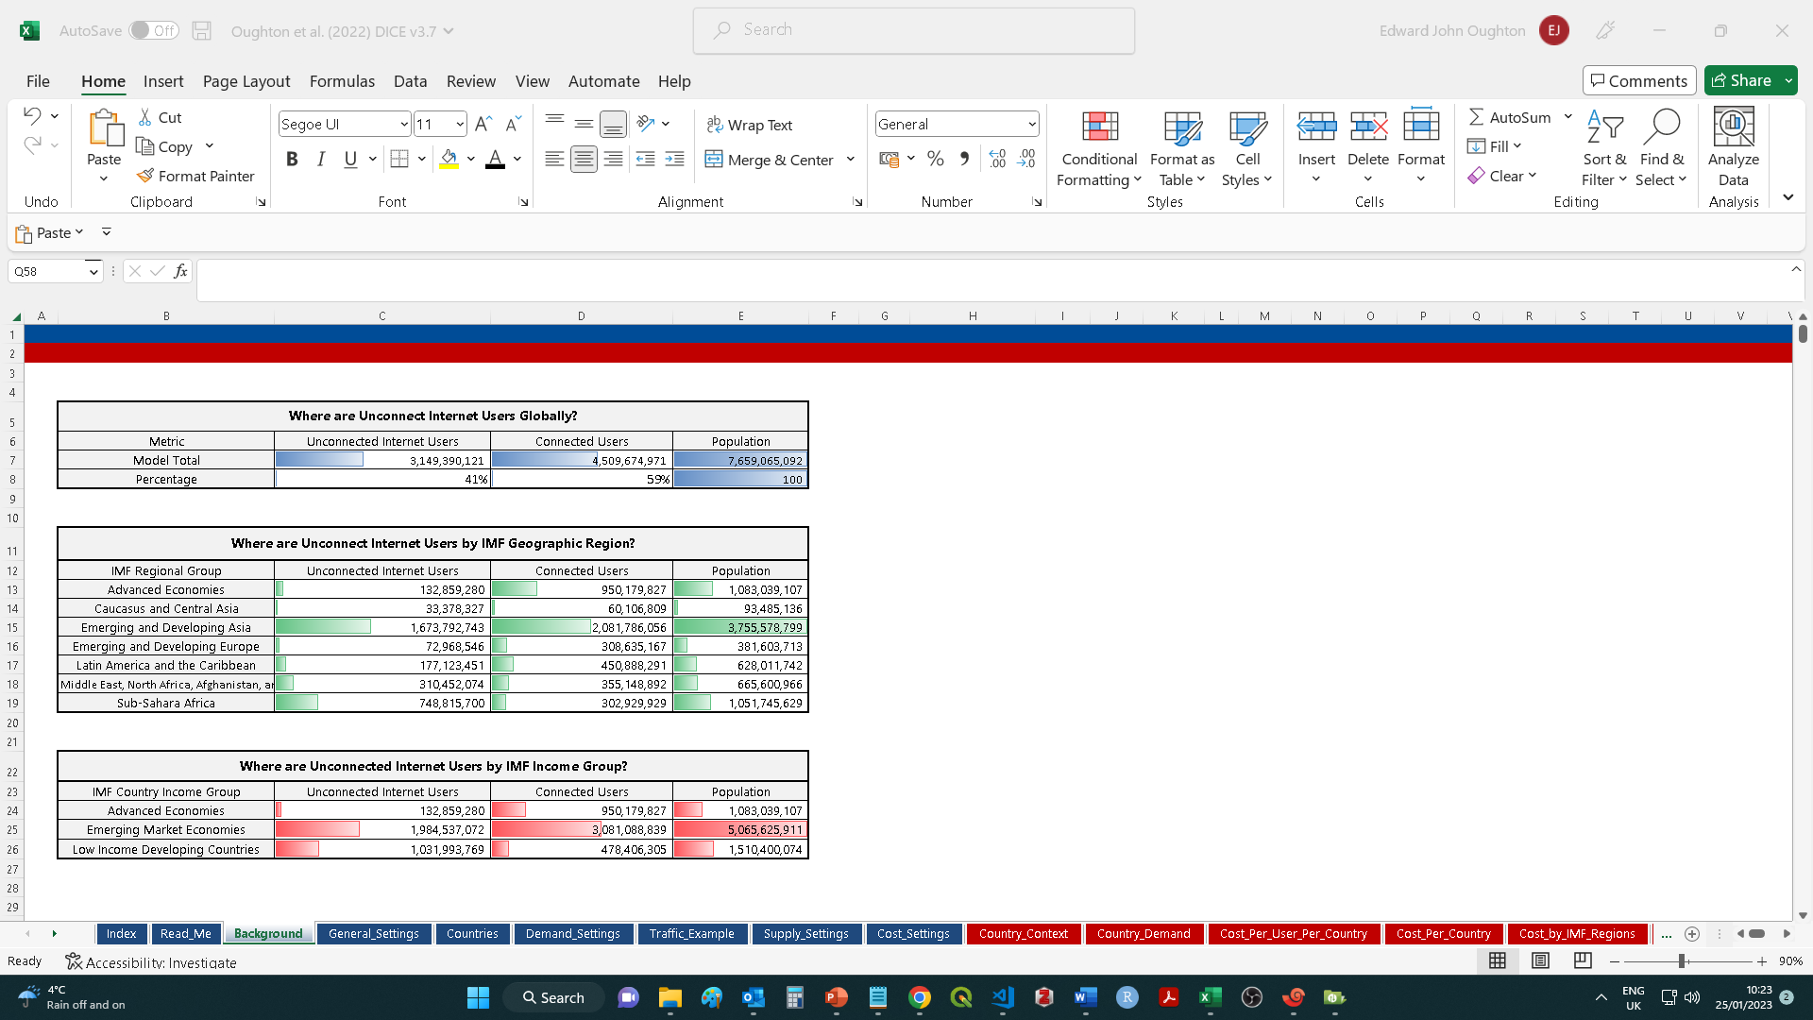
The Background Tab

Slide 25
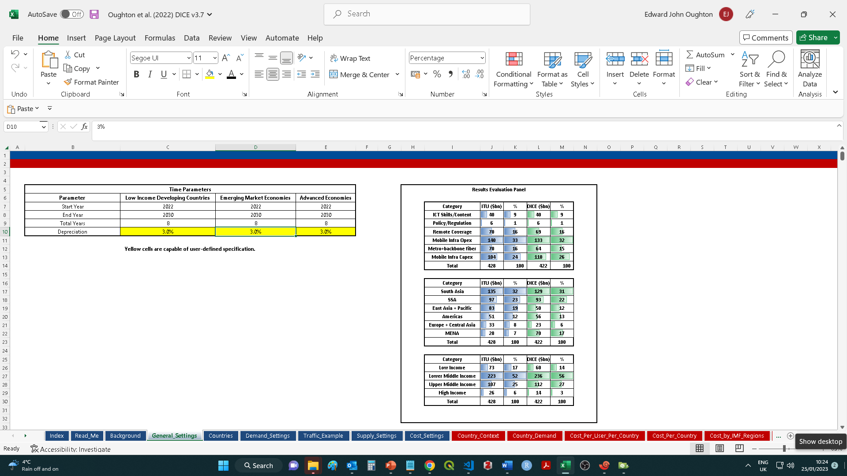
The General Settings Tab

Slide 26
The General Settings Tab
The general settings tab enables a user to view the temporal dimensions to the DICE model and explore the impact of bespoke depreciation rates.
A time period of 8 years is used in the baseline, between 2022 and 2030.
A depreciation rate of 3% is set as the baseline value.

Slide 27
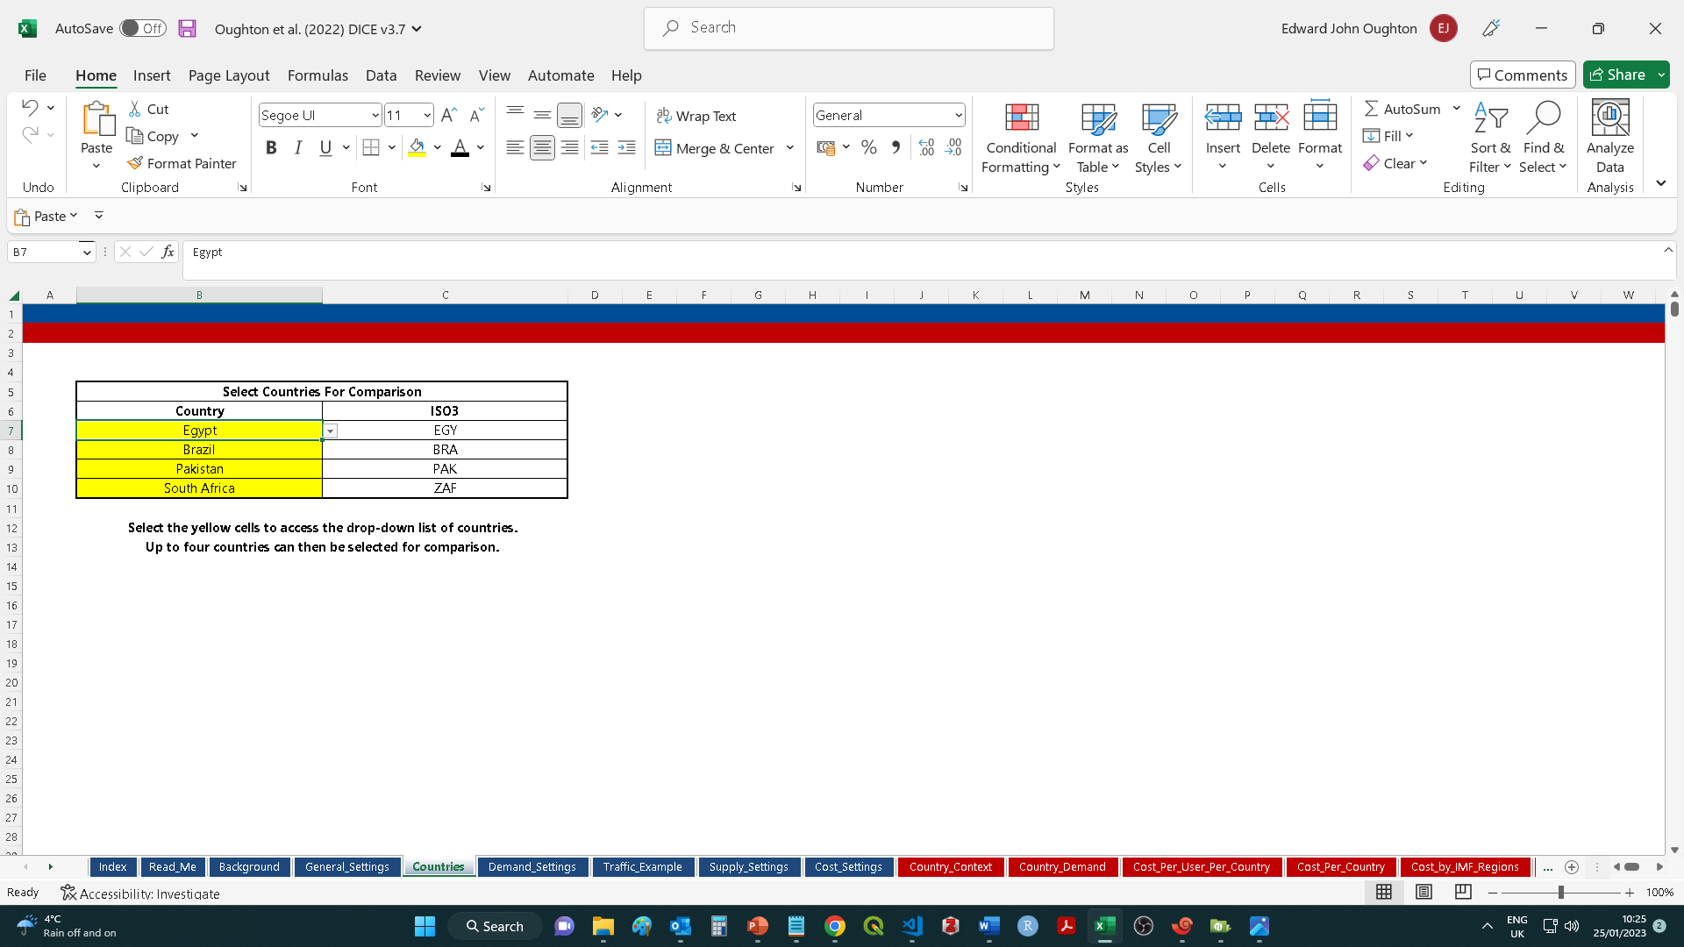
The Countries Tab

Slide 28
The Countries Tab
The countries tab enables a user to select up to four countries for comparison at once.
A user needs to click on the yellow cells which then produces a drop-down list of approximately 190 countries for selection.
Once a country name has been selected, the International Standards Organization (ISO) three-digit country code should auto-fill (ISO3), which is how DICE indexes across multiple different datasets used in the model to control for differences in how country names are defined.

Slide 29
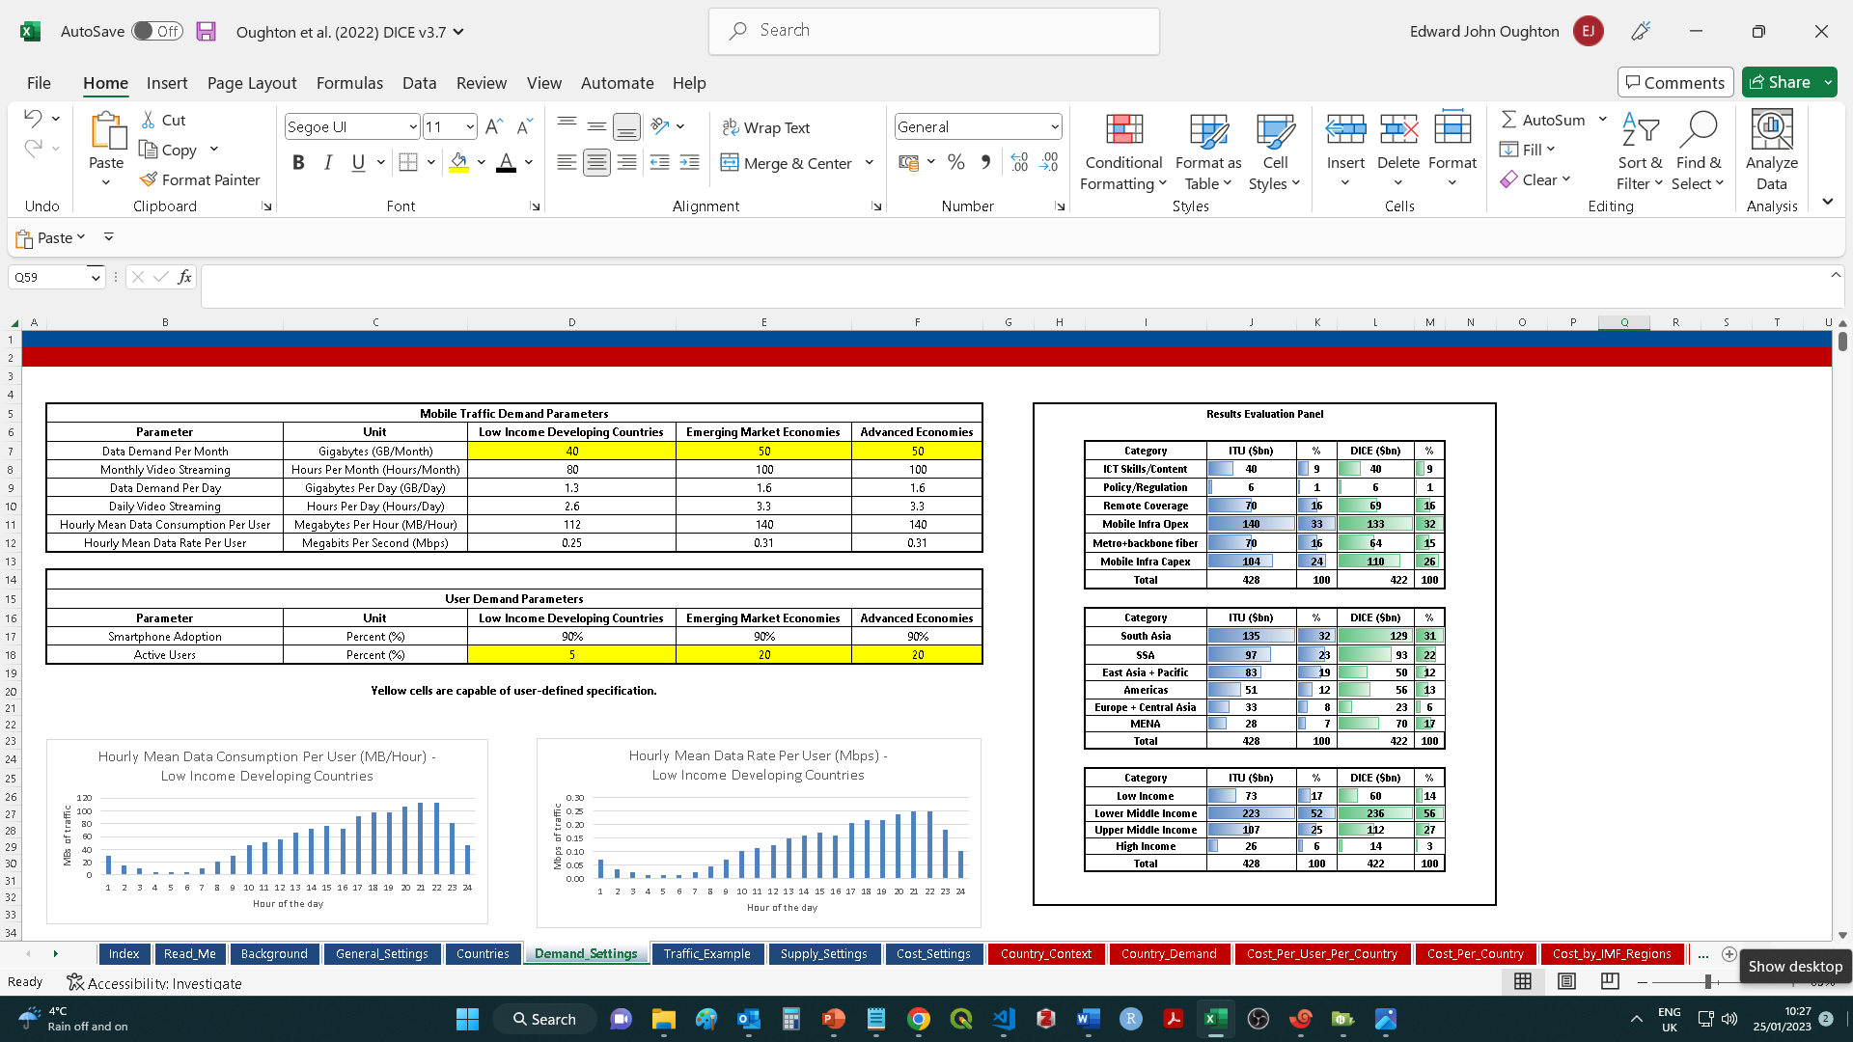
The Demand Settings Tab

Slide 30
The Demand Settings Tab
The demand settings tab enables a user to explore the impact of key demand parameters, such as traffic targets.
Data demand per month (GB) – Sets the monthly data consumption level per user. DICE builds capacity to either the minimum capacity per user or the pro rate share of data demand per month (whichever is larger). Based on mean hourly usage patterns, the monthly data consumption is automatically converted to a set of other metrics, including the number of monthly hours of video consumption enabled, and the hourly mean data rate per user.
Active Users (%) – Not all of the customers of an MNO are actively exchanging data with a local cell site. Traffic generally takes place in bursts, where a user receives a call or momentarily uses an app which updates creating a burst of traffic (rather than a continuous stream). Indeed, much of the time, a mobile cell phone may be idle. Therefore, this parameter defines how many users are actively exchanging data at any one time, which is typically one in twenty users, or 5% (as set in the baseline here).

Slide 31
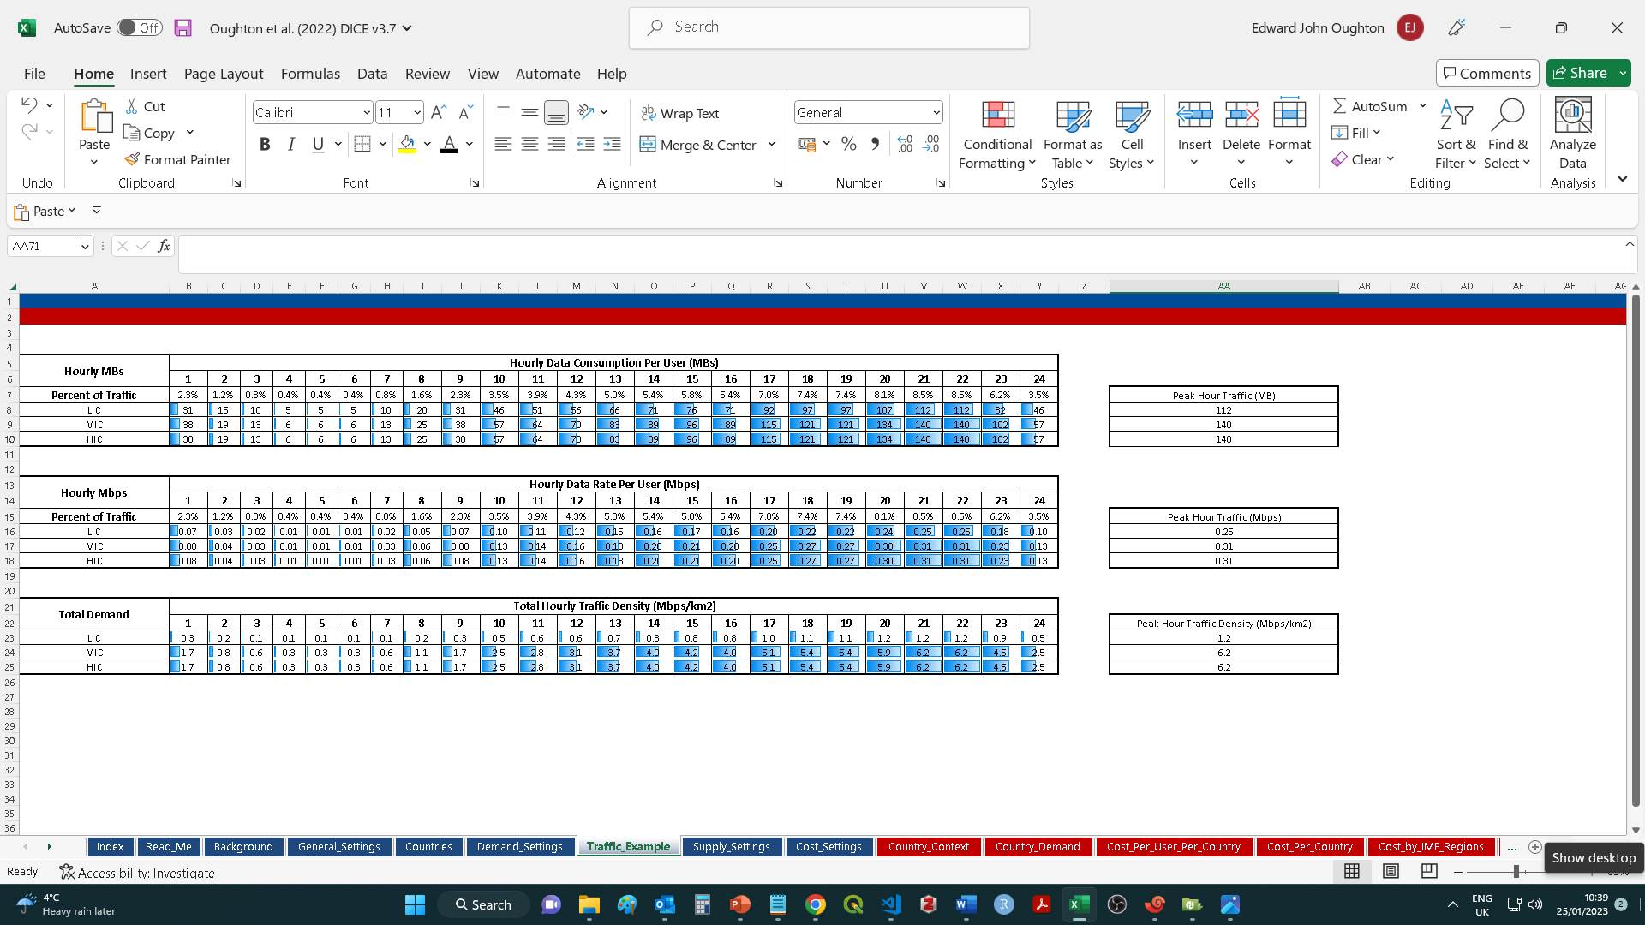
The Traffic Example Tab

Slide 32
The Traffic Example Tab
The traffic demand tab enables a user to understand how the monthly data consumption quantity selected in the demand settings tab converts to other important metrics.
For example, 50 GB per month converts to a mean hourly data consumption quantity of 140 MB. This hourly consumption value affects the connection speed which need to be achieved.
The hourly data rate (Mbps) is the connection speed required to serve the mean hourly data consumption quantity. For example, for an hourly rate of 140 MB at 9pm in the evening, a minimum connection speed is required of approximately 0.3 Mbps. During less busy periods of the day a user may experience much higher peak speeds, potentially up to 100 Mbps depending on the device, distance from the cell site etc..

Slide 33
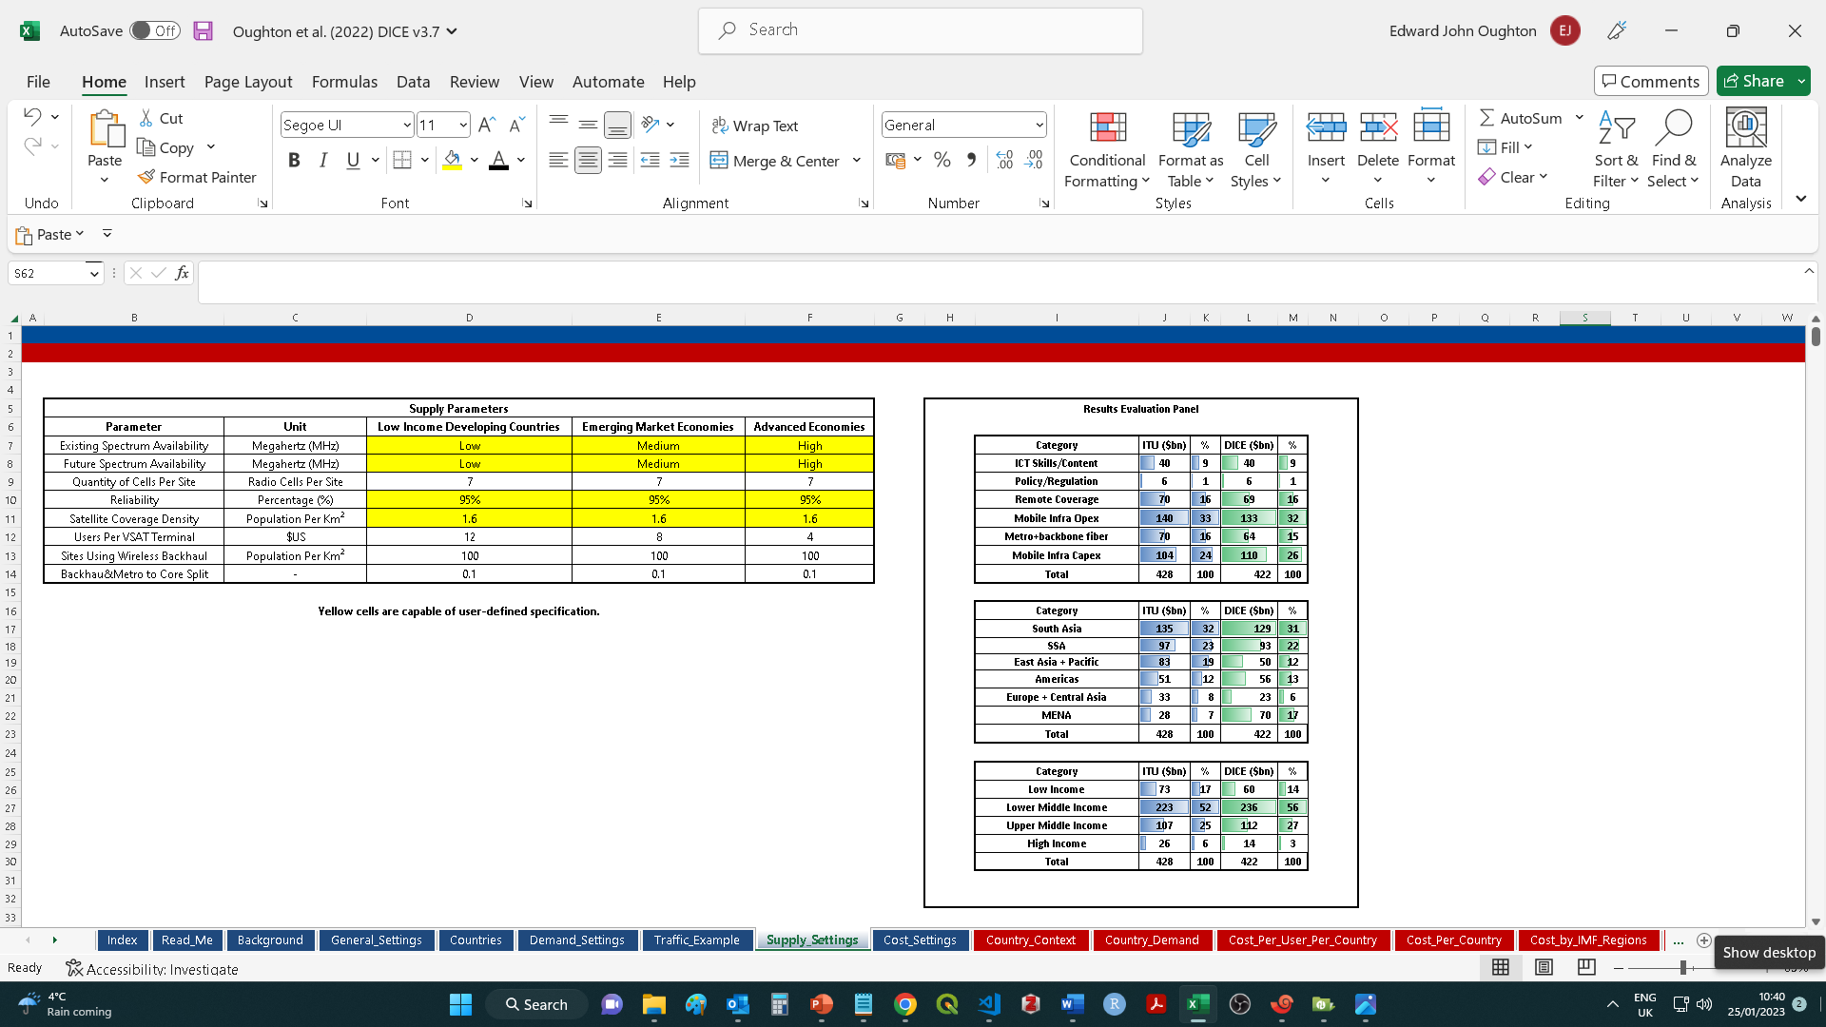
The Supply Settings Tab

Slide 34
The Supply Settings Tab
The supply settings tab enables a user to explore the impact of key supply-side infrastructure parameters, such as spectrum availability.
Existing Spectrum Availability – Set the available amount of spectrum currently in use for the initial capacity estimate. The baseline broadly correlates with a 10 MHz downlink at 800 MHz, which is a common method for deploying 4G around the world. The low option is effectively 5 MHz and the high option is 20 MHz. Generally, low income countries have smaller spectrum portfolios, whereas higher income countries have larger ones.
Future Spectrum Availability – Sets the available amount of future spectrum expected. The baseline broadly correlates with a 10 MHz downlink at 800 MHz, which is a common method for deploying 4G around the world. The low option is effectively 5 MHz and the high option is 20 MHz.
Reliability - Sets the reliability level for the provided service during the busiest hour of the day. The baseline focuses on providing a service with 95% reliability.
Satellite Coverage Density (km^2) – Sets the population density for areas to be served. The baseline is zero, meaning all areas will be targeted using the main infrastructure strategy (e.g., 4G). If this parameter was to be set to 2 persons per km^2, this would exclude all areas below this density from the DICE calculation. For example, as they are likely to be served by Low Earth Orbit satellite broadband constellations.

Slide 35
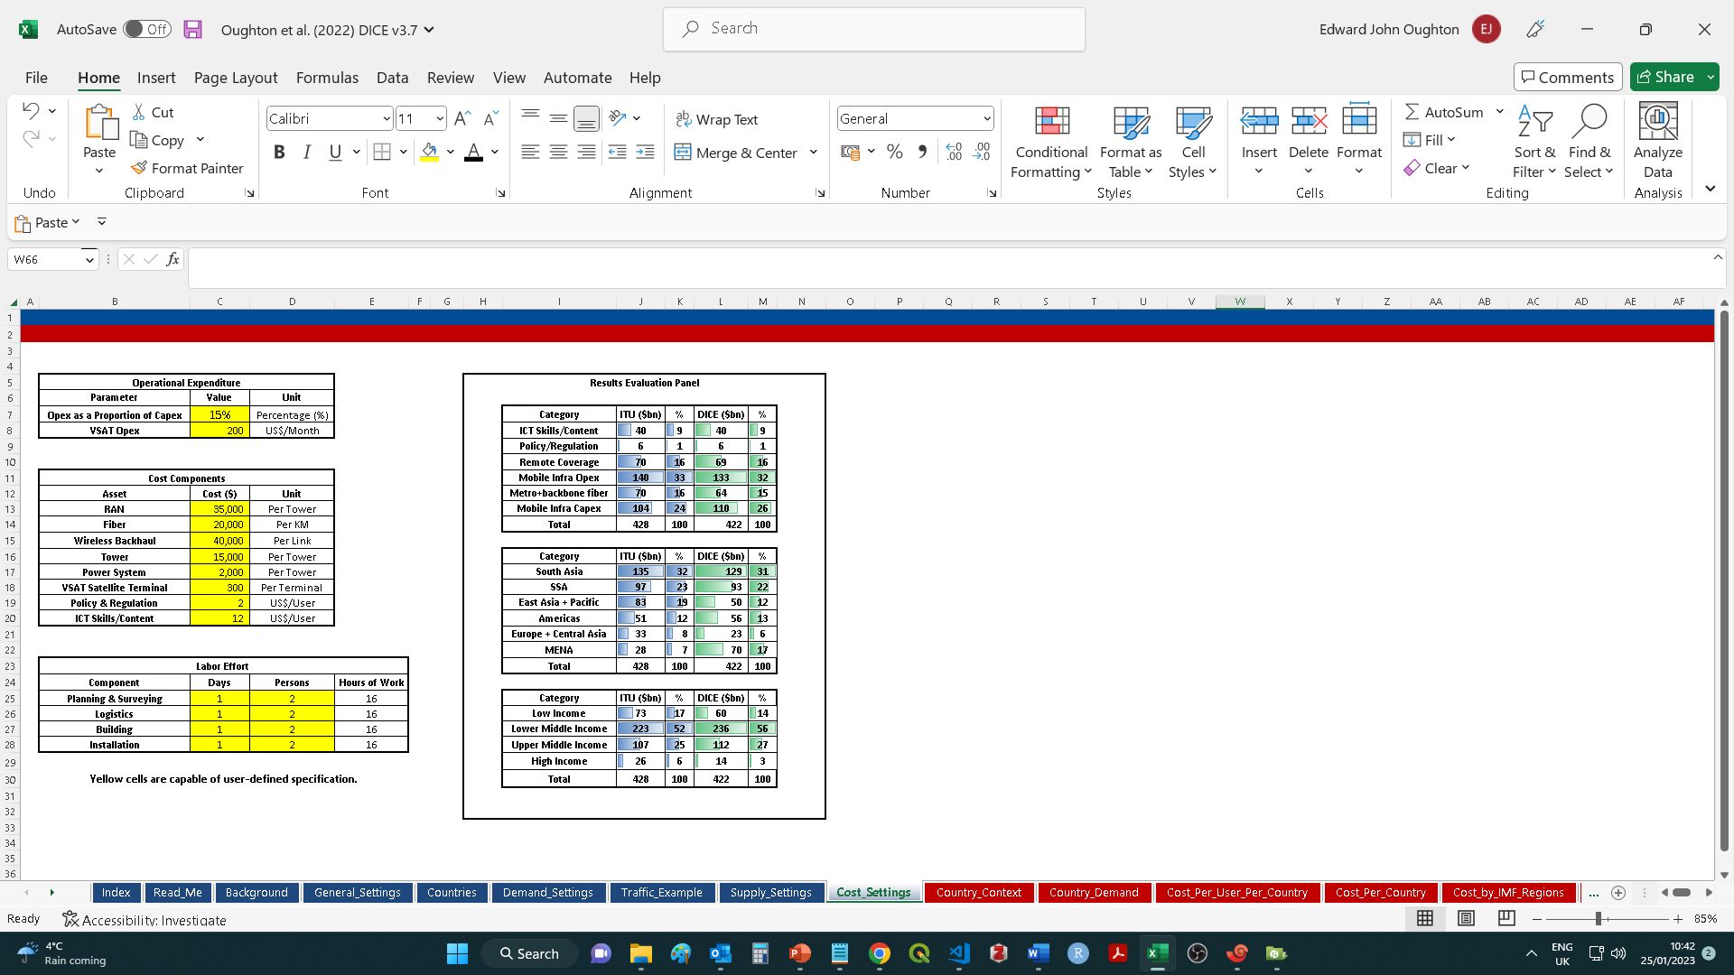
The Cost Settings Tab

Slide 36
The Cost Settings Tab
The supply settings tab enables a user to explore the impact of key supply-side infrastructure parameters, such as spectrum availability.
Opex as a Proportion of Capex – The annual opex of each asset as a percentage of the capex cost.
VSAT Opex – The annual opex cost per connection for a satellite broadband service.
RAN – Capex cost for Radio Access Network (RAN) equipment per site (antennas etc.).
Fiber – Capex cost for a fiber optic link per kilometer.
Wireless Backhaul – Capex cost for a wireless backhaul link per kilometer.
Tower – Capex cost for civil engineering activities to construct a single site.
Power System – Capex cost for a power system per site.
VSAT Terminal – Capex cost for a satellite broadband terminal.
Policy and Regulation – Capex cost per user to contribute to policy and regulatory activities.
ICT Skills / Content – Capex cost per user to contribute to ICT skill training and content.
Planning & Surveying – Number of labor hours required for Planning & Surveying per site.
Logistics – Number of labor hours required for construction material logistics per site.
Construction– Number of labor hours required for civil engineering construction per site.
Installation - Number of labor hours required for RAN installation per site.

Slide 37
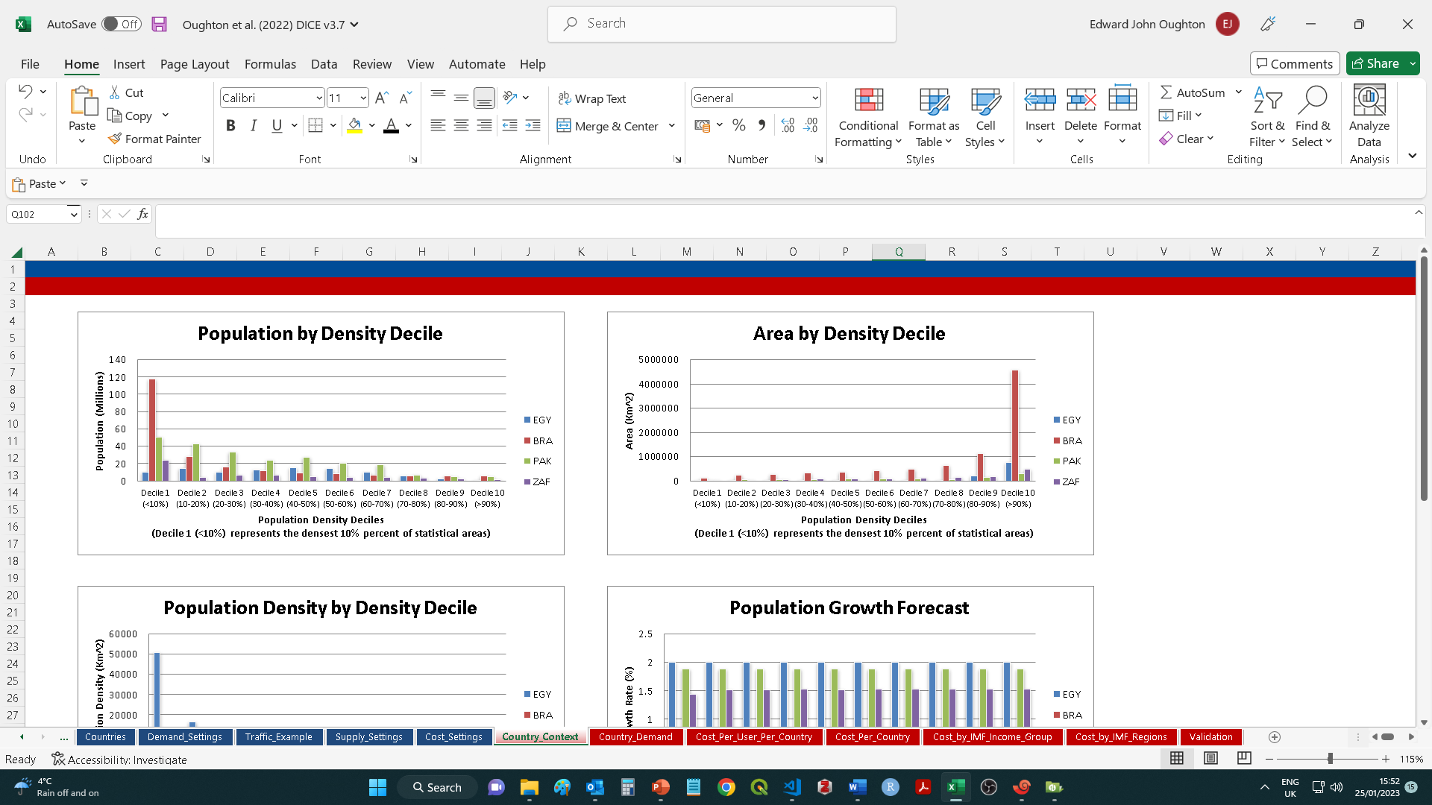
Results Metrics – Country Context Tab

Slide 38
Results Metrics – Country Context Tab
The results report the required universal broadband investment for (i) the four countries selected for comparison (by country and per user), (ii) the cost by income group for all countries, and (iii) the cost by geographic region for all countries.
The metrics provided in the country context tab include:
Population by Density Decile – The population by density decile.
Area by Density Decile– The geographic area by density decile.
Population Density by Density Decile – The population density by density decile.
Population Growth Forecast – The UN population growth forecast.
Unconnected Users by Density Decile – The unconnected users by density decile.

Slide 39
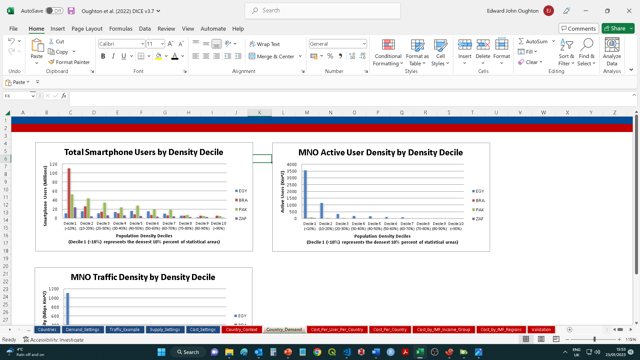
Results Metrics – Country Demand Tab

Slide 40
Results Metrics – Country Demand Tab
The metrics provided in the country demand tab include:
Total Smartphone Users by Density Decile – The total smartphone users by density decile.
MNO Active User Density by Density Decile – The number of active users in each density decile for the hypothetical modeled Mobile Network Operator.
MNO Traffic Density by Density Decile– The traffic density estimated for each population density for the hypothetical modeled Mobile Network Operator.

Slide 41
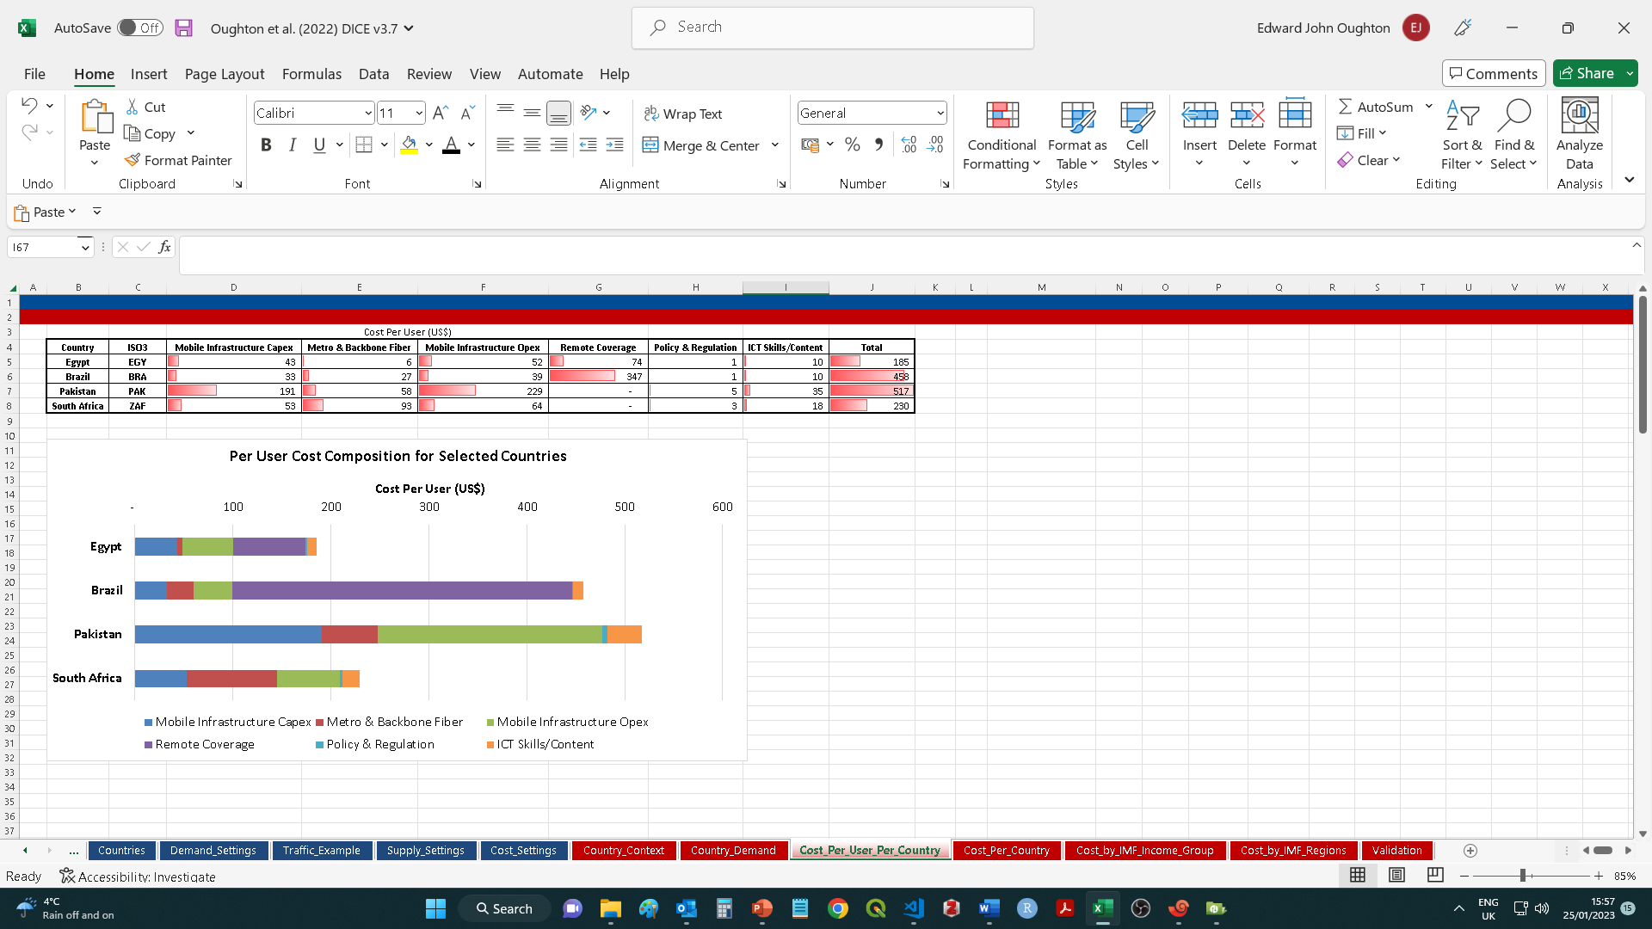
Results Metrics – Cost Per User Per Country

Slide 42
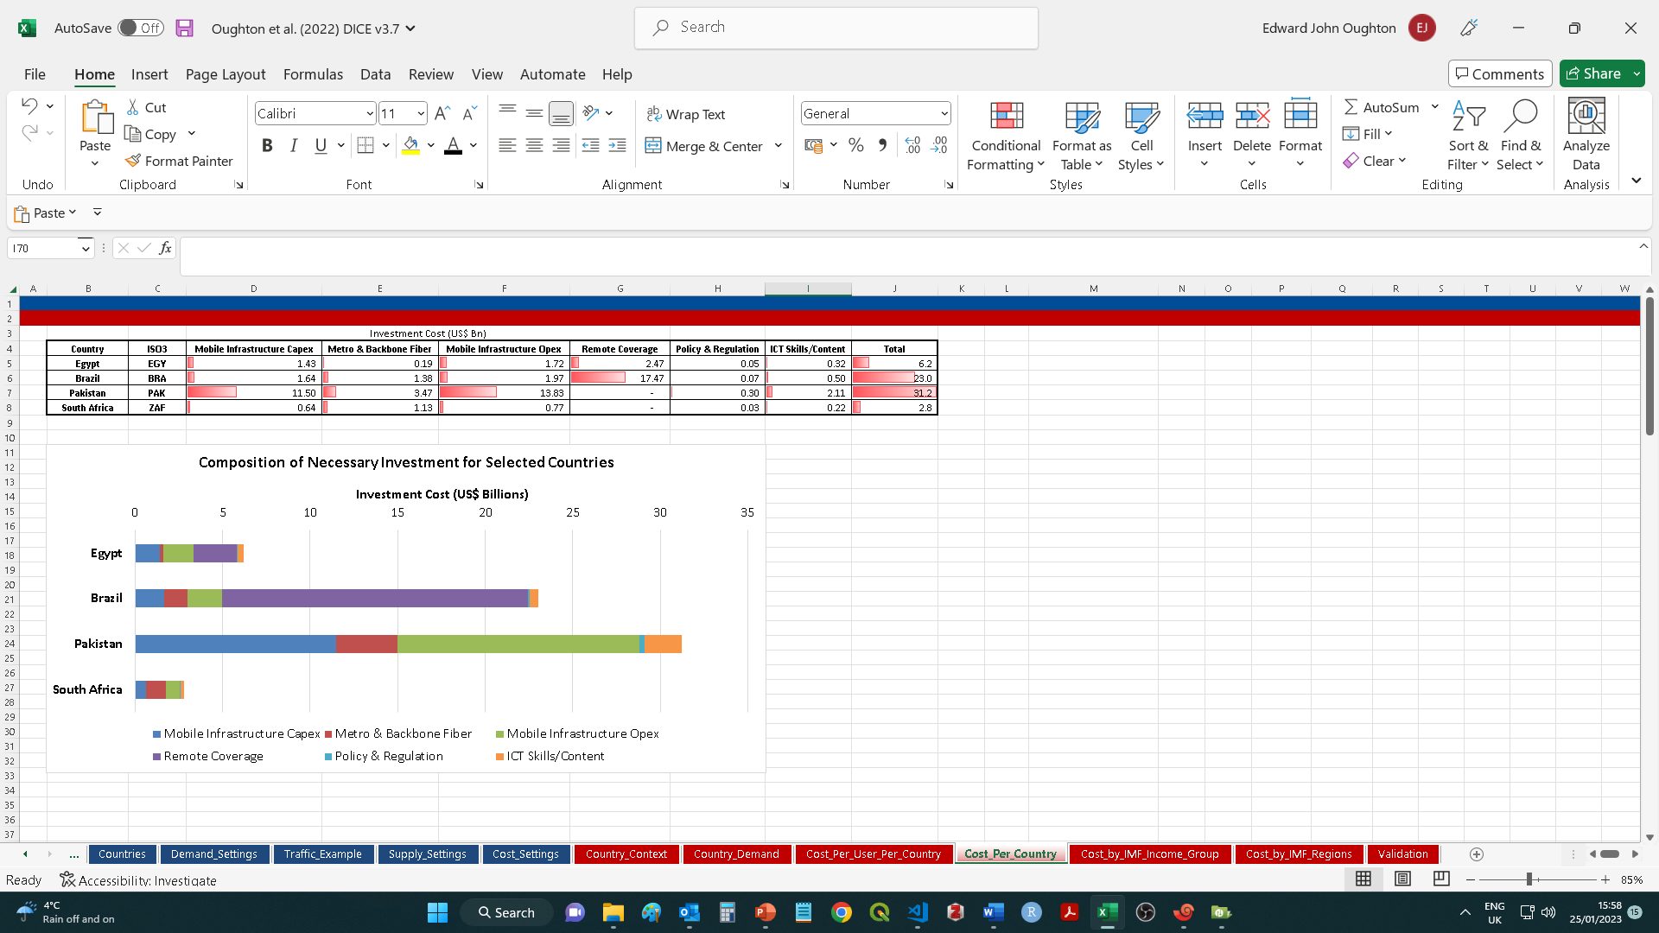
Results Metrics – Cost Per Country

Slide 43
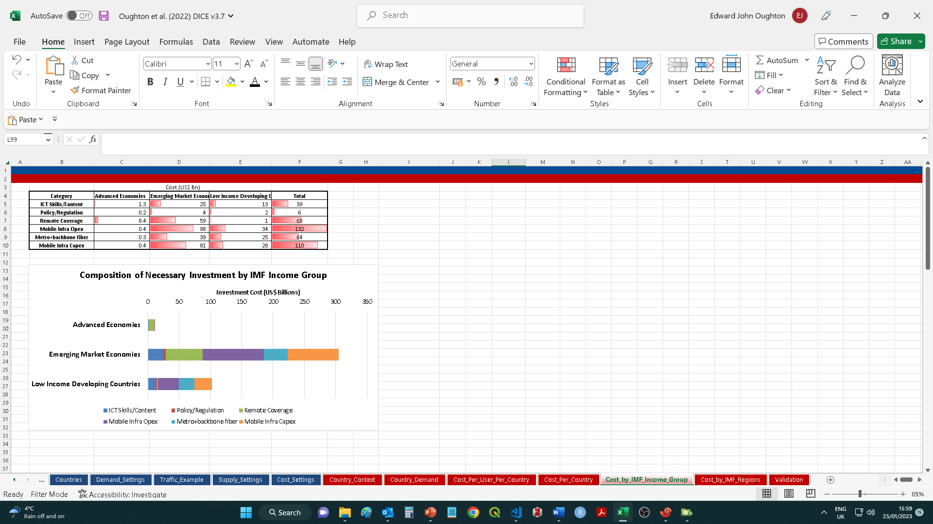
Results Metrics – Global Cost Per IMF Income Group

Slide 44
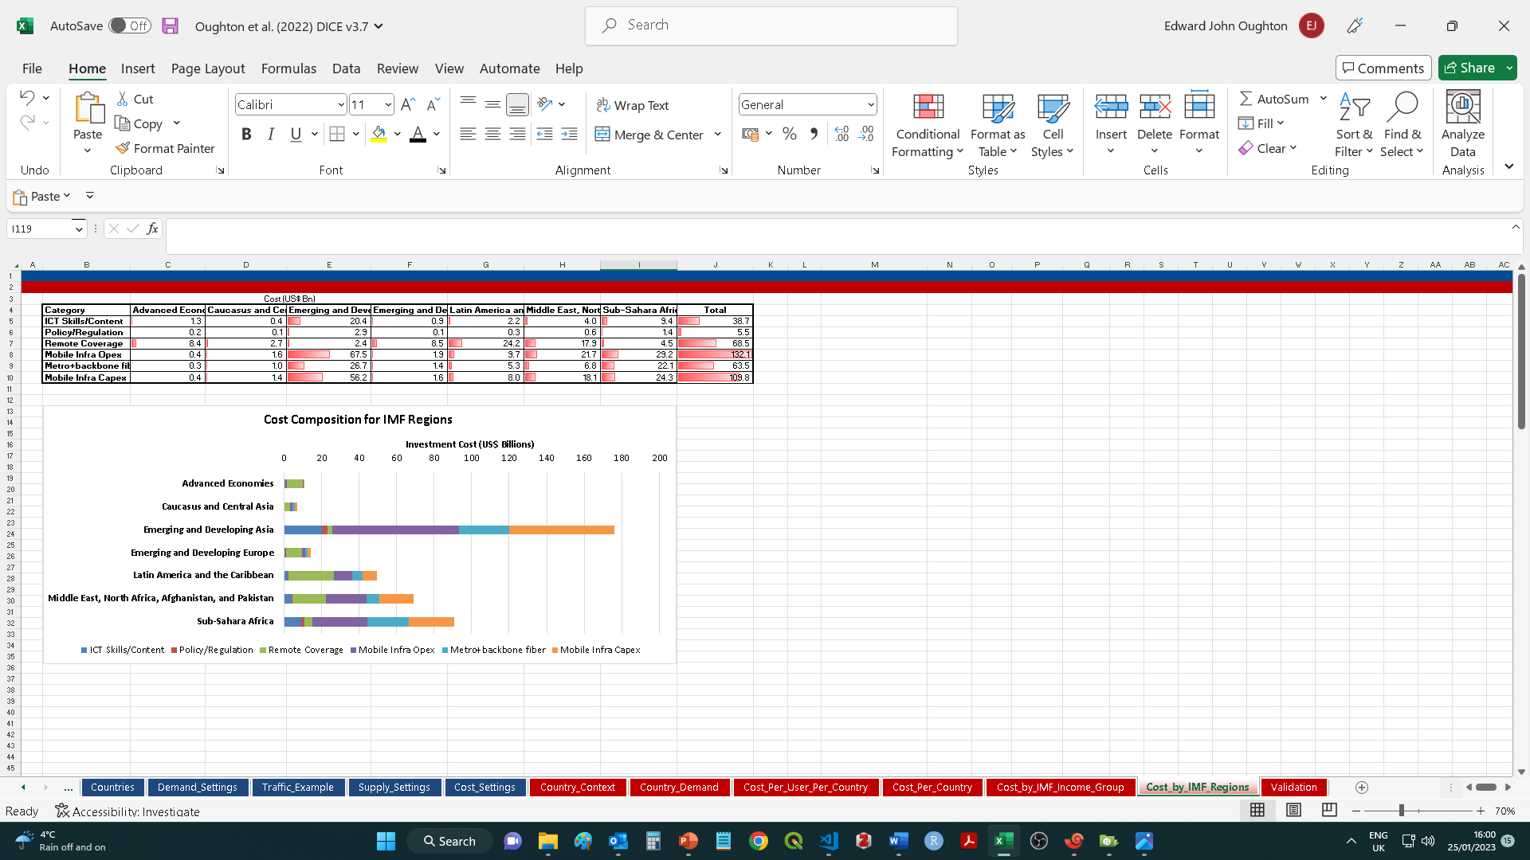
Results Metrics – Global Cost by IMF Region

Slide 45
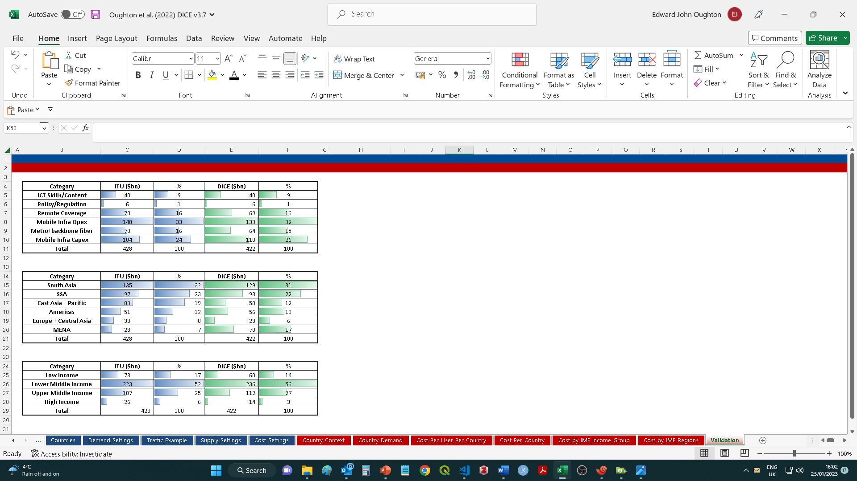
Results Metrics – Global Cost by IMF Region

Slide 46
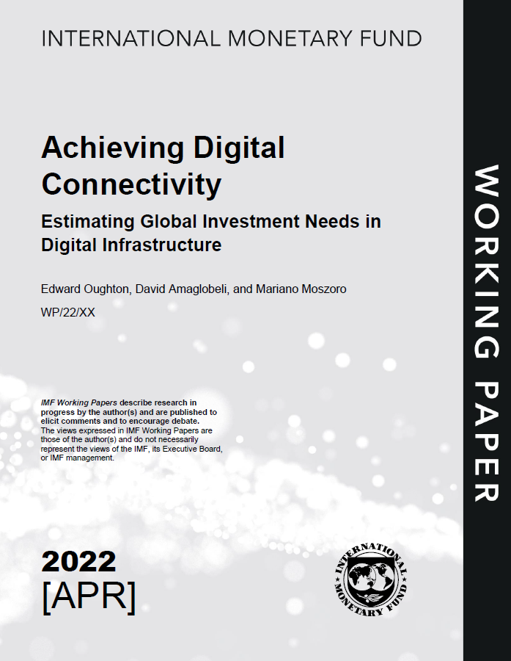
Further DICE Materials

Slide 47
Thank you! An Introductory Overview of the IMF Digital Infrastructure Costing Estimator (DICE)
January 2023
Expenditure Policy Division
Fiscal Affairs Department
Prepared by Edward Oughton, David Amaglobeli, and Mariano Moszoro

